Slide 1

Preliminary experimental studies on coalescer efficiency for liquid-liquid separation
Igor Matteo Carraretto
Department of Energy, Politecnico di Milano

Slide 2



Introduction
RES
FO
Objective of the work:
Procedure:
Preliminary characterization of a coalescer operations for the regeneration process (see next slide)
Experimental campaign with a commercial mesh and polymer

Slide 3



Full Desolination plant
Solar plant
tCO₂ –mix power plant
Water storage
Nanofiltration
Desalination plant
receiver
I
4
Turbine
generator
Compressor
(only for recompressed cycle)
H
Coalescer
solar tower
$$\sim$$
Air Cooled unit
Direct two tanks Thermal Energy Storage (TES)
X
F
Primary heat exchanger
5
2
C
B
Heliostat field
G
Y
FO membrane
pump
3
1
E
D
A
High temperature recuperator
Low temperature recuperator
Condenser
recuperator

Slide 4
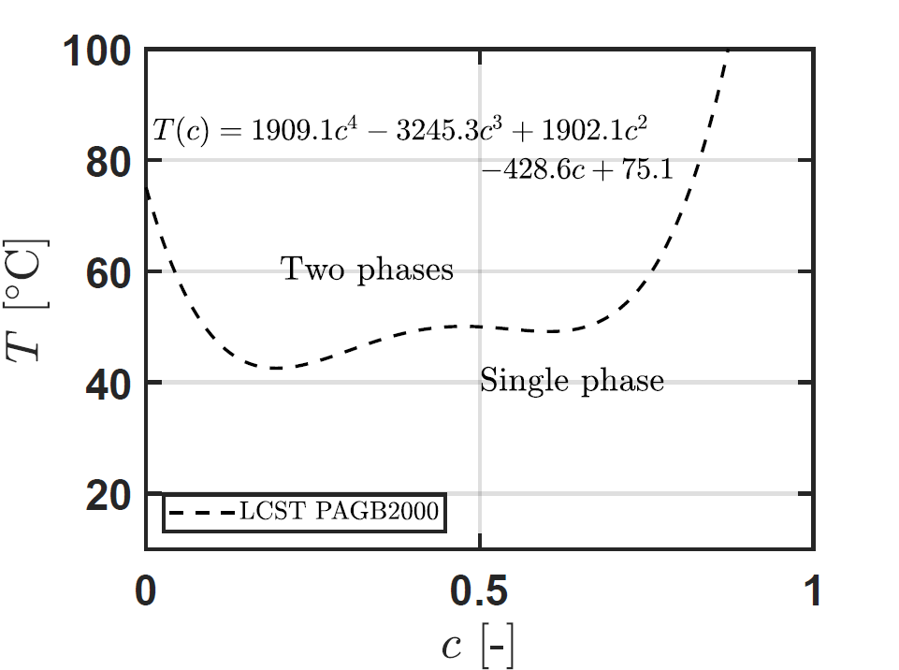
Draw agent and FO plant proposed
Draw agent: PAGB2000
Water storage
Nanofiltration
Desalination plant
Thermoresponsive co-polymer
Regeneration process: diluted and concentrated phases are obtained
I
Coalescer
H
Air Cooled unit
F
C
B
G
FO membrane
E
D
A
Condenser
recuperator

Slide 5
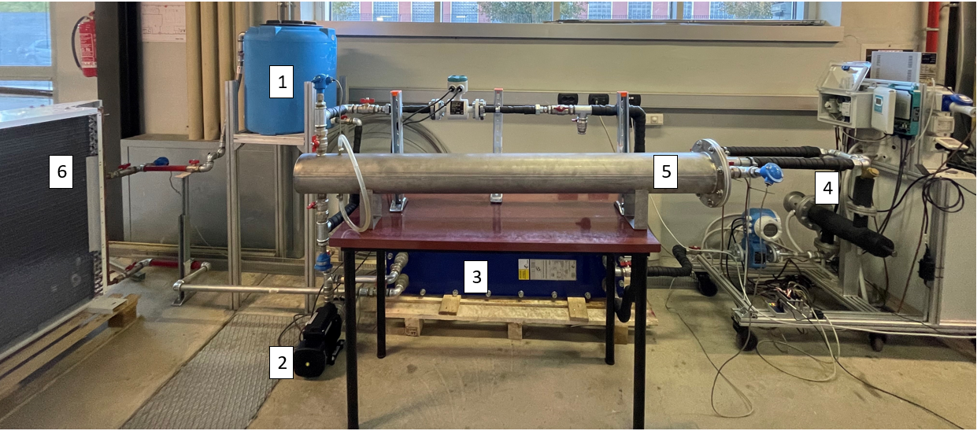
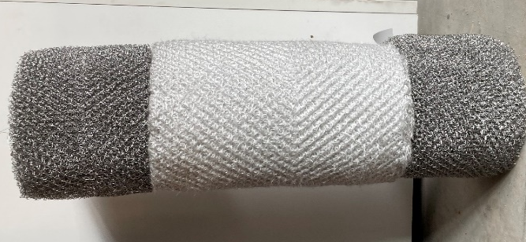
Laboratory set-up
Tank
Centrifugal Pump
HEx
Electric Heaters
Coalescer
Air cooler

Slide 6
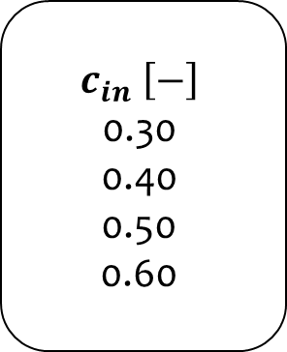
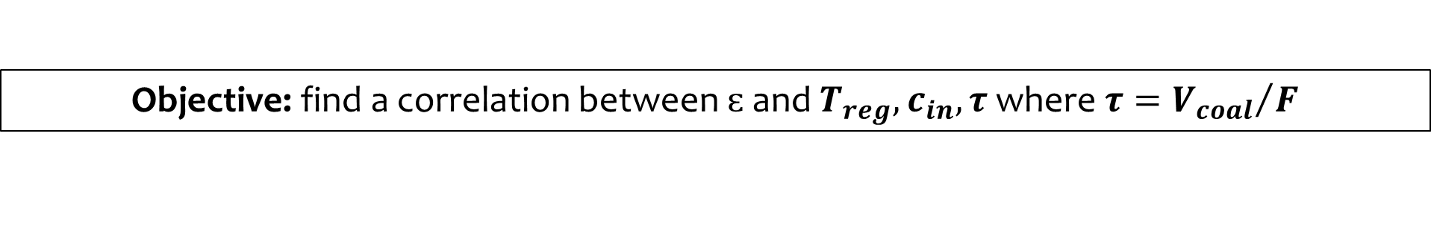
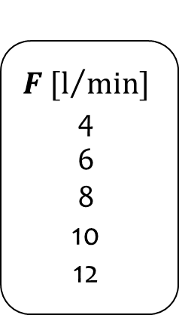
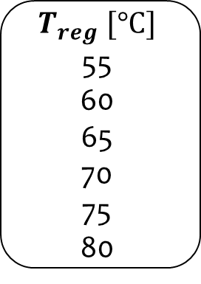
Methodology for efficiency determination
Objective: find a correlation between $ɛ$ and $T_{reg},c_{in},τ$ where $τ={V_{coal}}/F$
Operating conditions:
Concentration measurement:
Collect three samples of diluted and concentrated phases, with a time step of 15 minutes
Wait until samples are cooled
Measure the concentration using the refractometer
Compute average and standard deviation
$$c_{in} \left[−\right]$$
0.30
0.40
0.50
0.60
$$T_{reg} [°C]$$
55
60
65
70
75
80
$$F [l/{min}]$$
4
6
8
10
12
Wait for the steady state
Choose a new operating condition

Slide 7
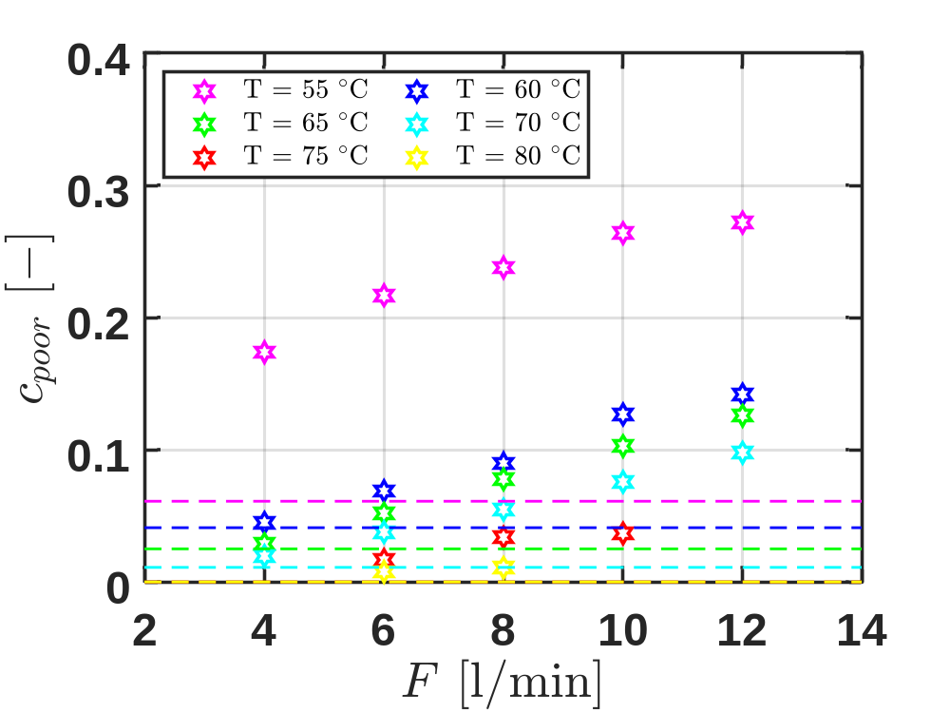
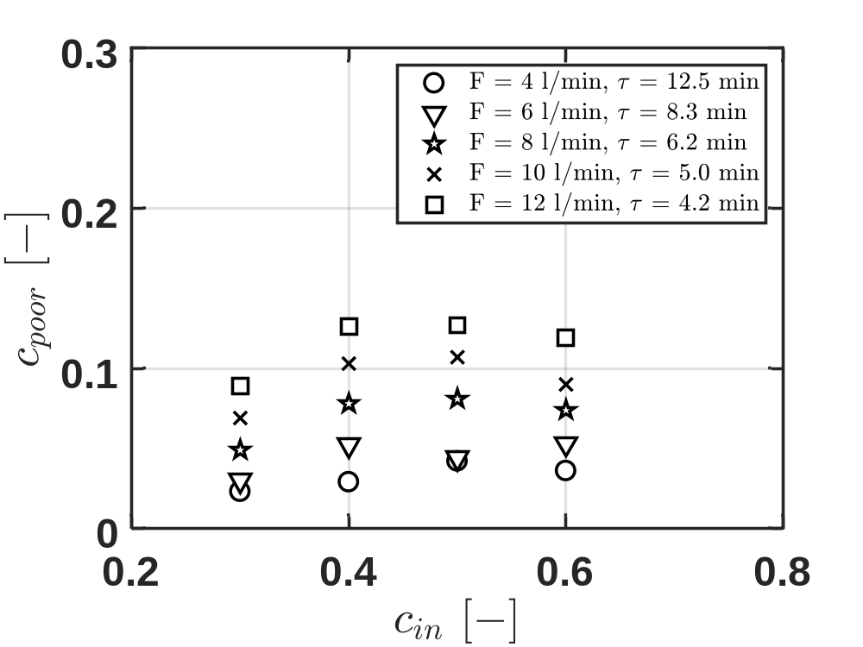
Concentration measurements

Slide 8
Concentration measurements
Temperature is the most significant parameter concerning coalescer performances
The initial draw concentration has negligible impact on the coalescer performance
Higher flow rates lower the fluid residence time, decreasing diluted phases quality

Slide 9
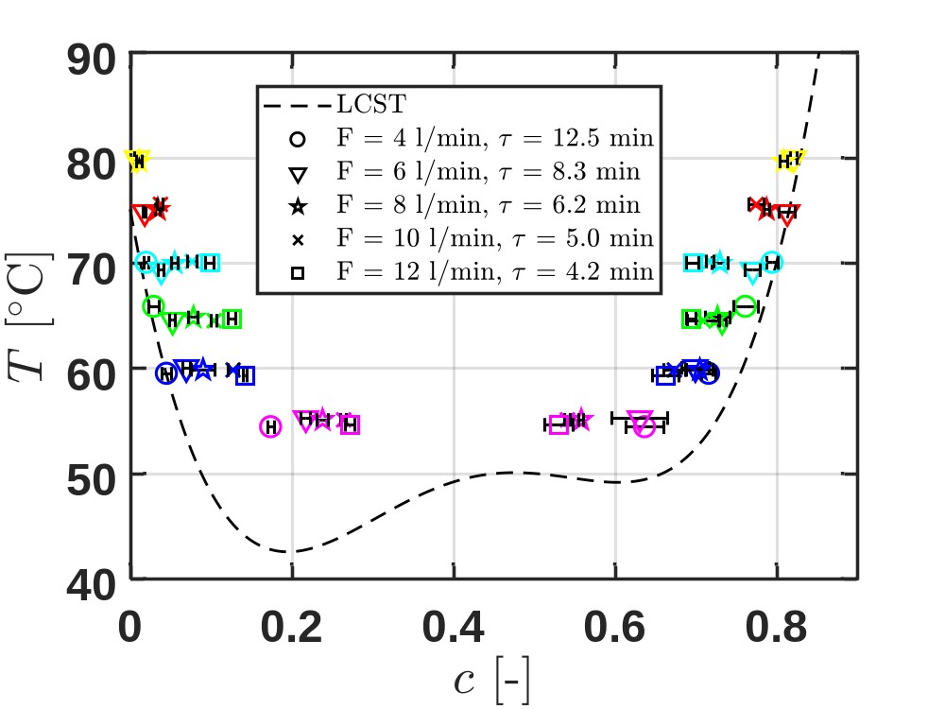
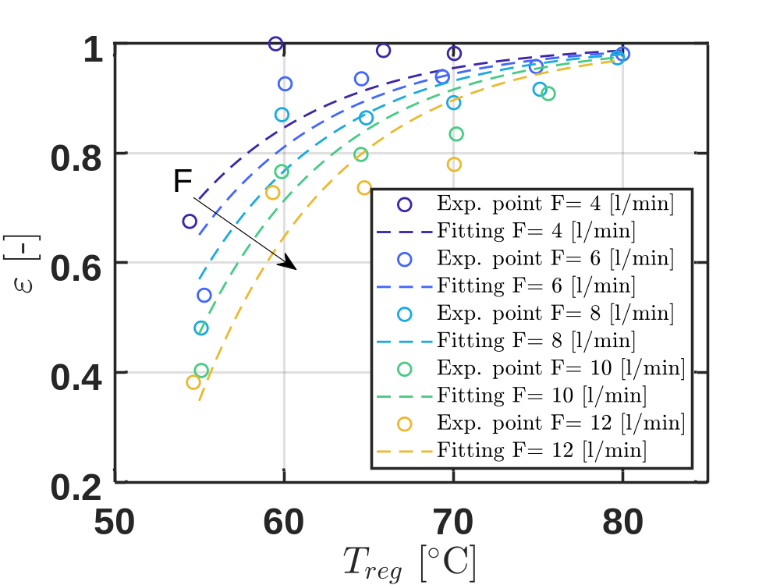
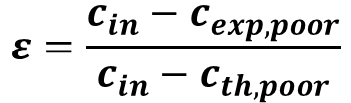
Concentration measurements to efficiency
$$ε=\frac{c_{in}−c_{exp,poor}}{c_{in}−c_{th,poor}}$$

Slide 10
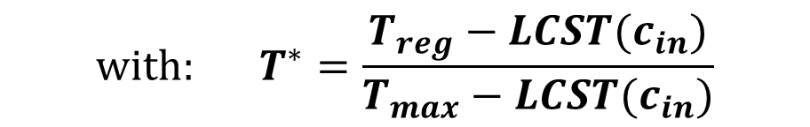
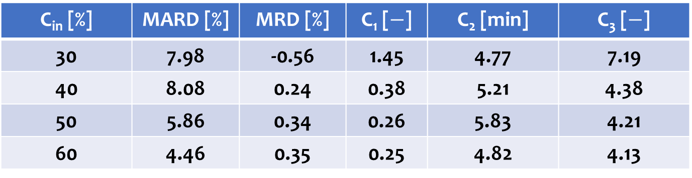
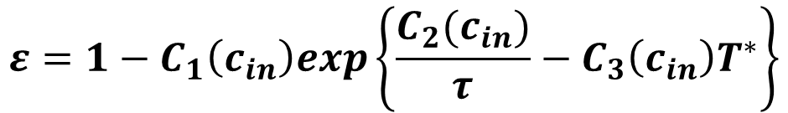
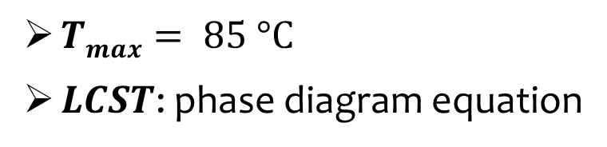
Coalescer efficiency: fitting surfaces
$$ε=1−C_{1}\left(c_{in}\right)exp\left\{\frac{C_{2}(c_{in})}{τ}−C_{3}\left(c_{in}\right)T^{∗}\right\}$$
$${with: T}^{∗}=\frac{T_{reg}−LCST(c_{in})}{T_{max}−LCST(c_{in})}$$
$Tmax= 85 °C$
$LCST$: phase diagram equation
C_{in} [%] | MARD [%] | MRD [%] | C₁ [$−$] | C₂ [min] | C₃ [$−$]
30 | 7.98 | -0.56 | 1.45 | 4.77 | 7.19
40 | 8.08 | 0.24 | 0.38 | 5.21 | 4.38
50 | 5.86 | 0.34 | 0.26 | 5.83 | 4.21
60 | 4.46 | 0.35 | 0.25 | 4.82 | 4.13

Slide 11
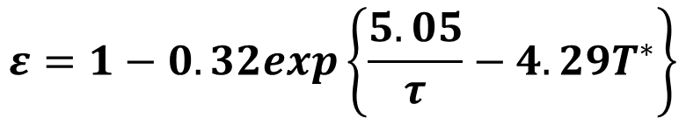
Coalescer efficiency: fitting surfaces
$$ε=1−C_{1}\left(c_{in}\right)exp\left\{\frac{C_{2}(c_{in})}{τ}−C_{3}\left(c_{in}\right)T^{∗}\right\}$$
$${with: T}^{∗}=\frac{T_{reg}−LCST(c_{in})}{T_{max}−LCST(c_{in})}$$
$Tmax= 85 °C$
$LCST$: phase diagram equation
$$ε=1−0.32exp\left\{\frac{5.05}{τ}−4.29T^{∗}\right\}$$

Slide 12
Conclusions
Characterization of the effectiveness of a coalescer for liquid-liquid separation
A coalescer employing a thermo-responsive polymer can be deployed for its regeneration
The thermo-responsive polymer PAGB2000 was tested
The experiments investigated the coalescer under various operating conditions, including initial solution concentrations, regeneration temperatures, and flow rates
The coalescer has a very high separation efficiency (ε > 90%)
  It increases as Temperature increases
  It decreases as the Flow-rate is reduced
An efficiency expression was derived starting from a typical efficiency expression of mass transfer
Future research will focus on evaluating performance using alternative thermo-responsive draw agents and metal meshes

Slide 13




This research activity was carried out within NEST and DESOLINATION projects
NEST - Network 4 Energy Sustainable Transition (D.D. 1243 02/08/2022, PE00000021) and received funding under the National Recovery and Resilience Plan (NRRP), Mission 4 Component 2 Investment 1.3, funded from the European Union - NextGenerationEU
The DESOLINATION project has received funding from the European Union’s Horizon 2020 research and innovation programme under grant agreement #101022686
This presentation reflects only the authors’ views and opinions, neither the European Union nor the European Commission can be considered responsible for them

Slide 14
Preliminary experimental studies on coalescer efficiency for liquid-liquid separation
I M Carraretto, D Scapinello, R Bellini, L P M Colombo, L Molinaroli and G Manzolini
Thank for your attention!
igormatteo.carraretto@polimi.it

