Slide 1
Non solo energia: il progetto H2020 Desolination
Gioele Di Marcoberardino – Università degli Studi di Brescia
Il Ruolo dell’Ingegneria nella Transizione verso il Futuro
VII Convegno del Dipartimento di Ingegneria Meccanica ed Industriale

Slide 2
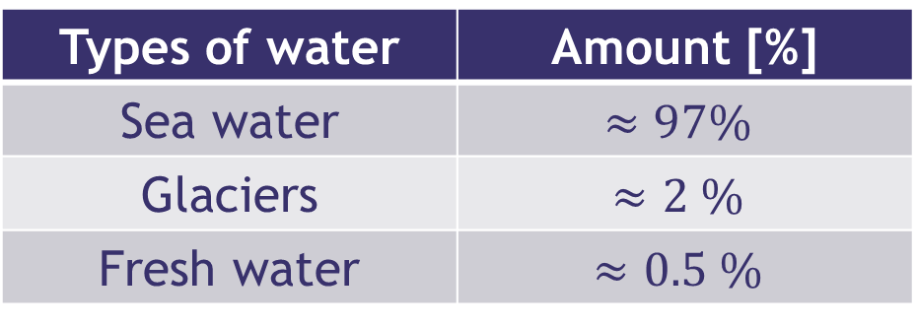
Motivation
Call: H2020-LC-SC3-2020-NZE-RES-CC
Efficient combination of Concentrated Solar Power and desalination (with particular focus on the Gulf Cooperation Council (GCC) region)
Seawater desalination plant coupled with
concentrated solar power plant (CSP)
DESALINATION UNIT
CSP UNIT
Why?
Forward Osmosis (FO)
Advanced CSP plant
opposed to Reverse Osmosis (RO)
exploits low grade/waste heat
low electrical consumptions expected
purification step: DCMD or NF
seawater as feed
concentrated solar power plant
recompressed CO₂ supercritical cycle
solar driven
advanced features
Types of water | Amount [%]
Sea water | $$≈97\%$$
Glaciers | $$≈2 \%$$
Fresh water | $$≈0.5 \%$$
Need to develop technologies capable of producing drinking water from sea water

Slide 3

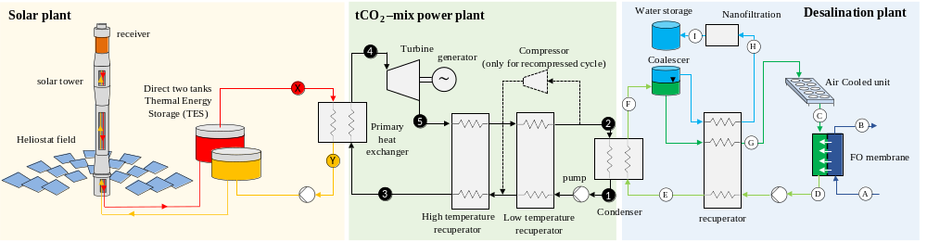




The concept
CO₂ blends in power block
  higher performance
  lower costs
Forward Osmosys and membrane distillation:
  low energy cost
Desalination section – FO+MD
Metal recovery
FO
MD
ZLD
Symbiosis: No energy waste, No efficiency penalty
Sea Water
Lower cost of water
< 1 €/m³
Lower cost of electricity
< 90 €/MWh
O
Reduced CO₂ emissions by >30%
C
Pure Water
O

Slide 4
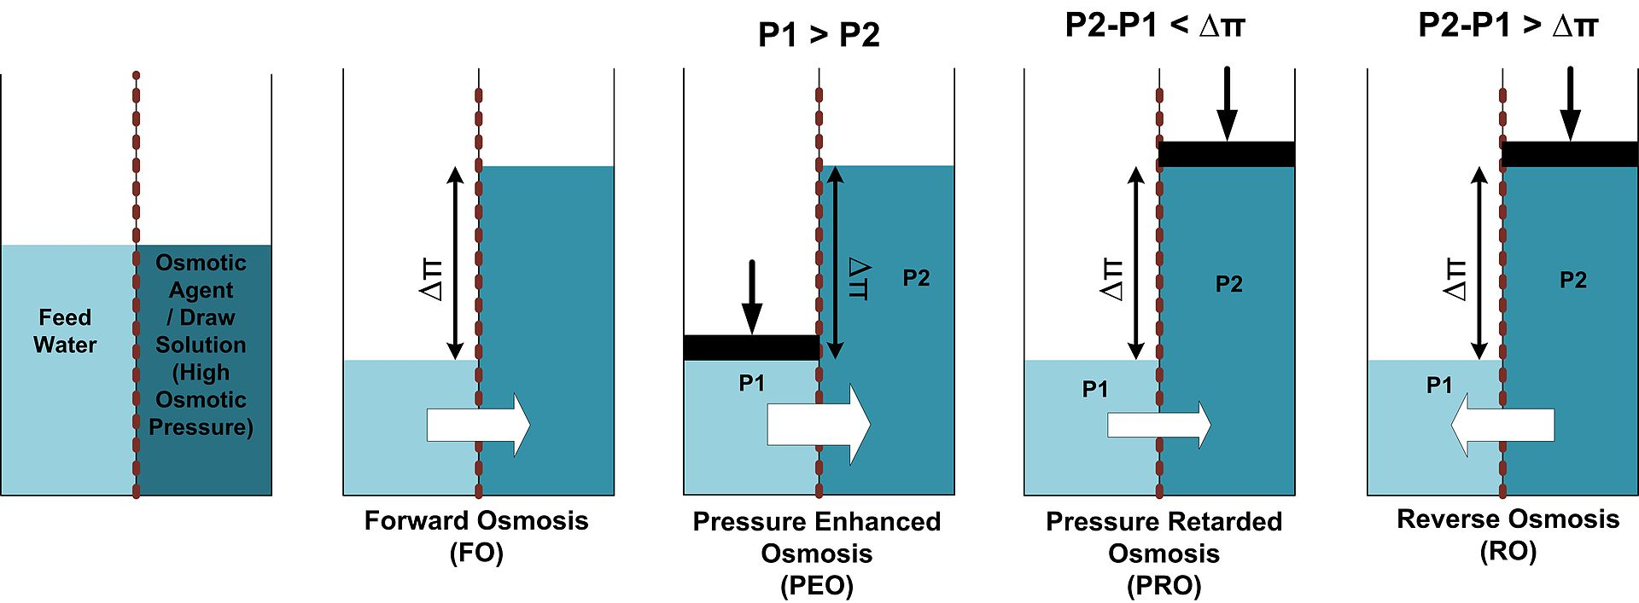


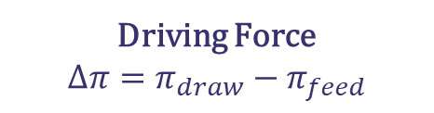
Options for combining solar energy and desalination
Desalination Technologies
Evaporation & Condensation
Filtration
Mechanical process
Thermal process
Mechanical Vapor Compression (MVC)
Multi-Effect Distillation (MED)
Multi-Stage Flesh (MSF)
Solar Still Distillation (SSD)
Thermal Vapor Compression (TVC)
Humidification Dehumidification (HDH)
Solar Chimney (SC)
Reverse Osmosis (RO)
Forward Osmosis (FO)
Nanofiltration (NF)
Ion-Exchange Resin (IXR)
Membrane Distillation (MD)
Electro-Dialysis (ED)
Capacitive Deionization (CDI)
REVERSE OSMOSIS
FORWARD OSMOSIS
Driving Force
$${ΔP=P}_{ext}−P_{amb}$$
Driving Force
$$Δπ=π_{draw}−π_{feed}$$
Water flux
$$J=A(ΔP+Δπ)$$

Slide 5
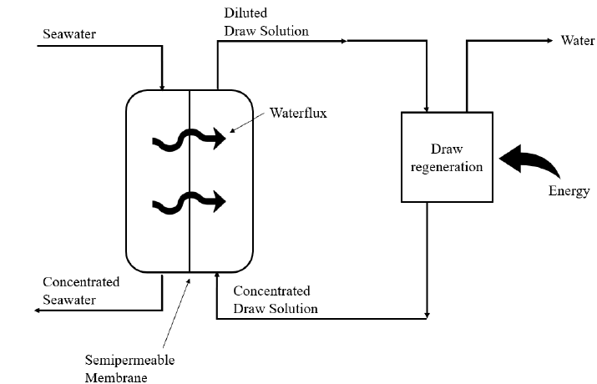
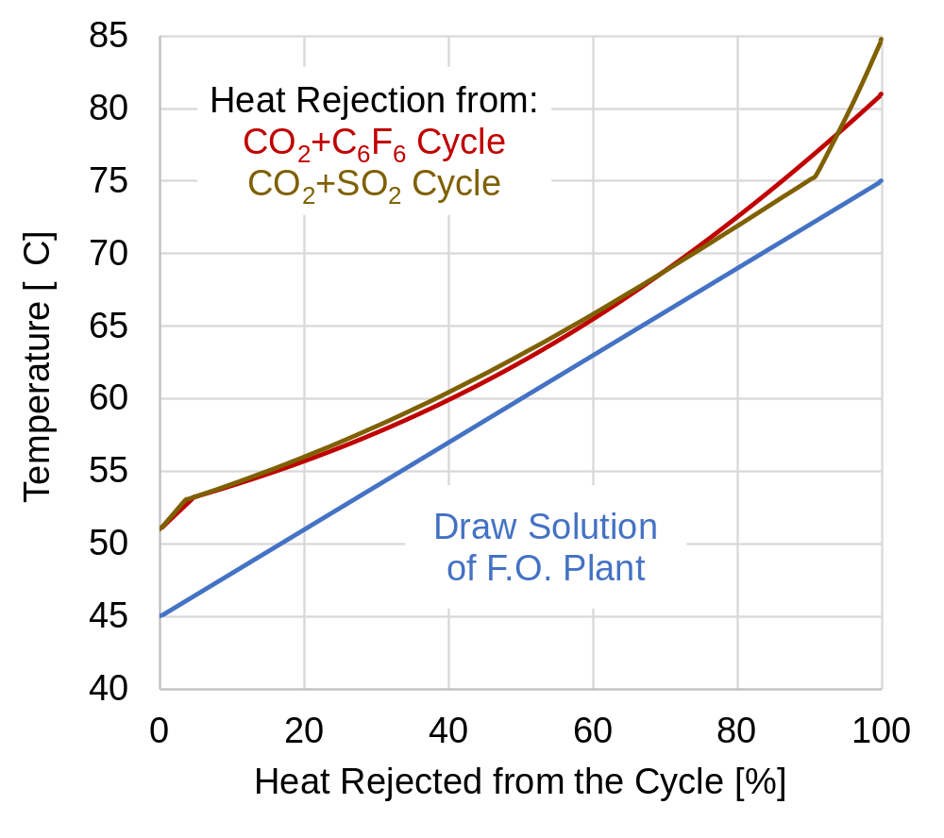
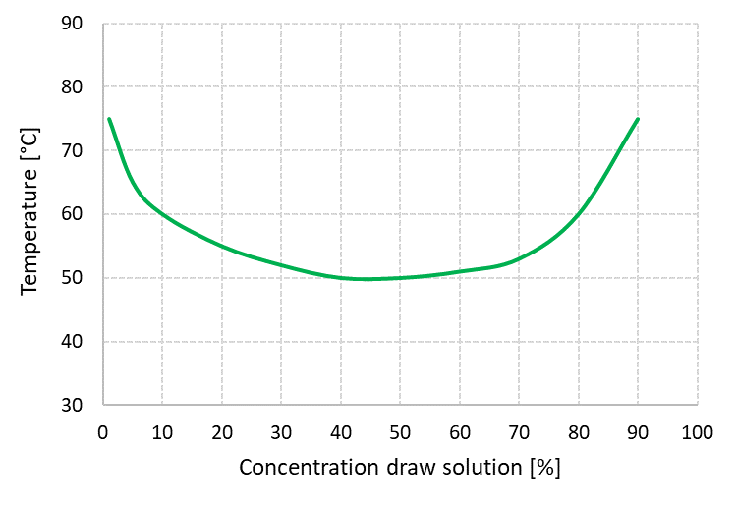
Why DESOLINATION? - Advantages of tCO2-blends and Forward Osmosis
C
A
B
Heat rejection curve from tCO2 cycles
D
Win-Win
Draw solution + water phase diagram
Two phase
C
D
B
A
One phase

Slide 6
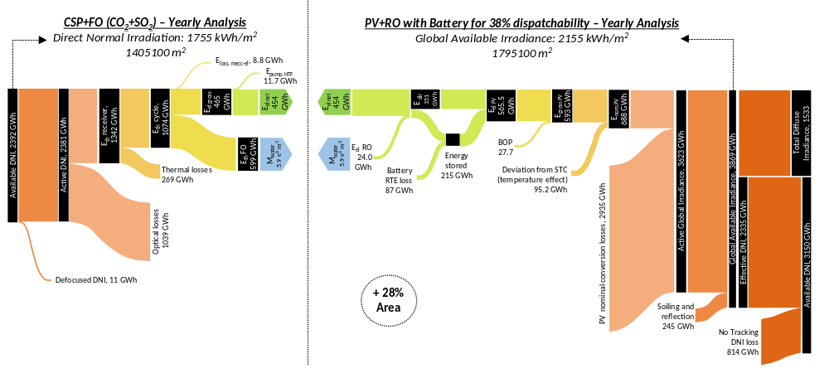

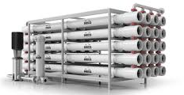
Why DESOLINATION?
+28% area
PV + RO

Slide 7


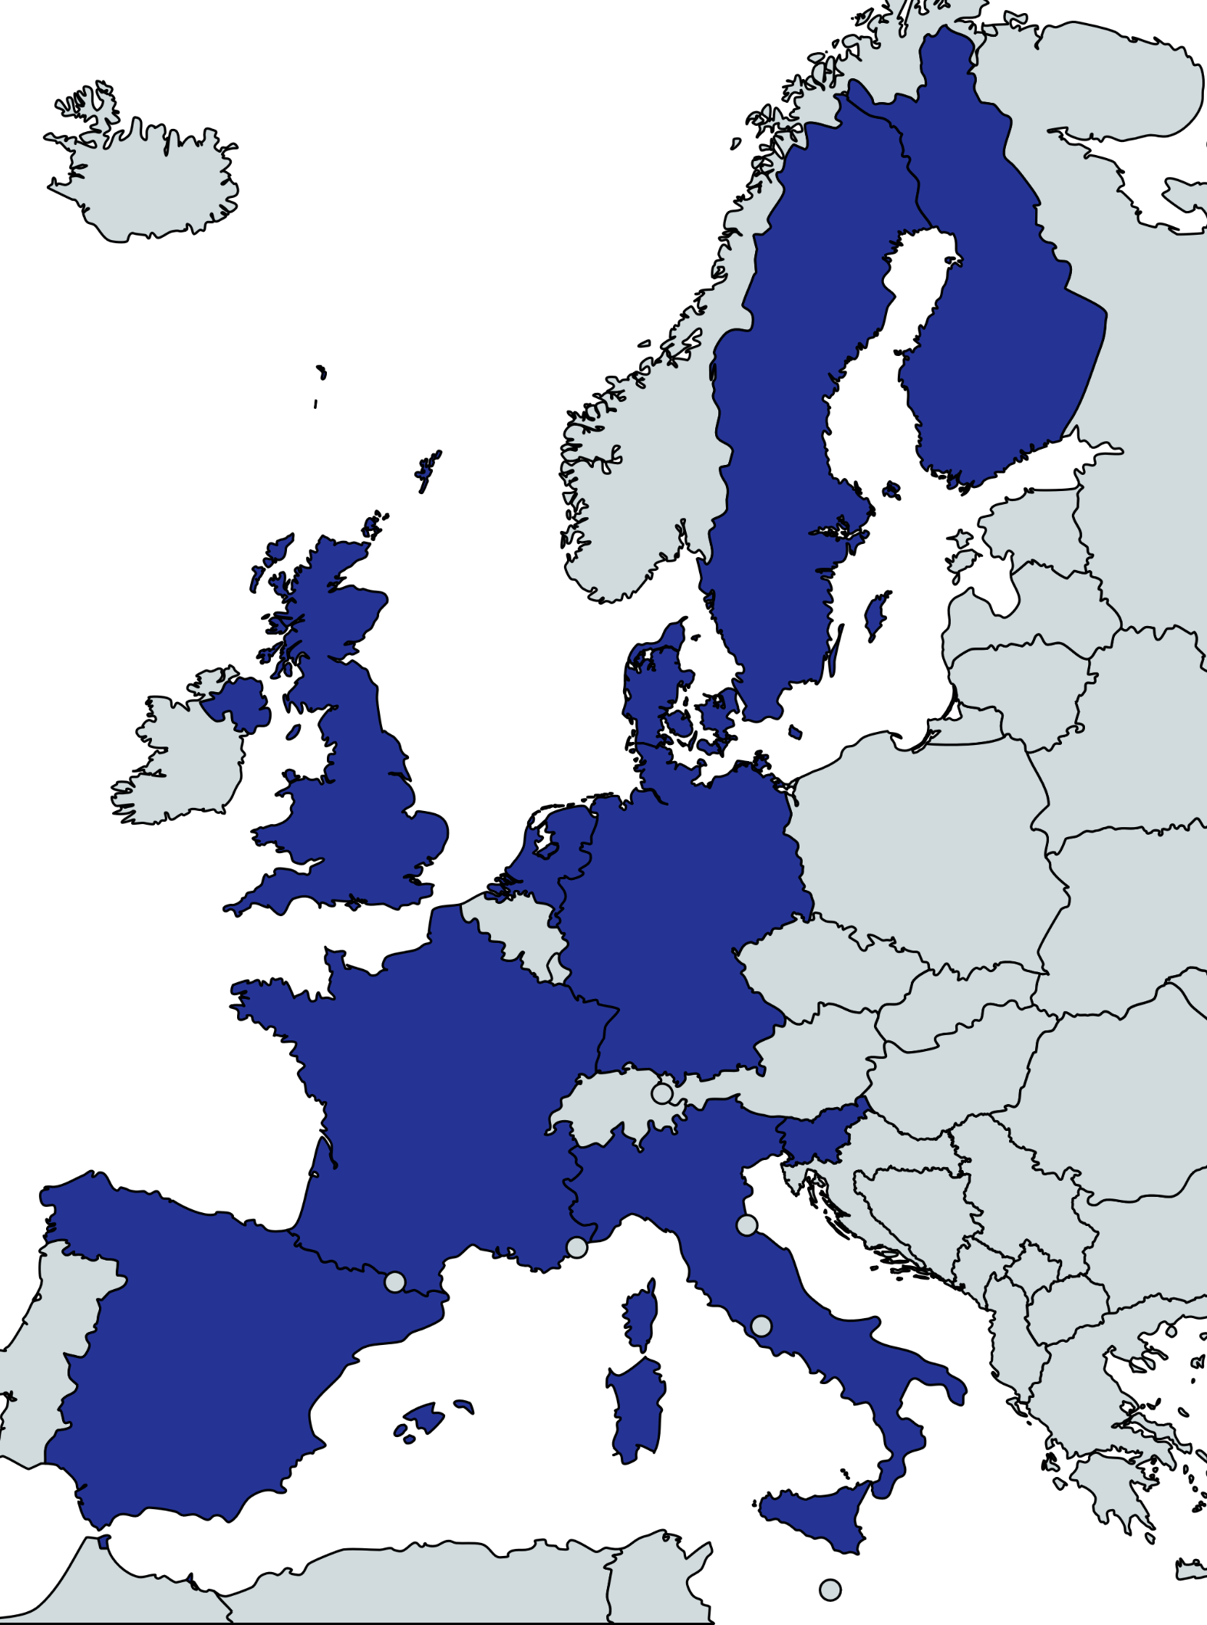



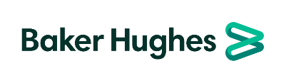


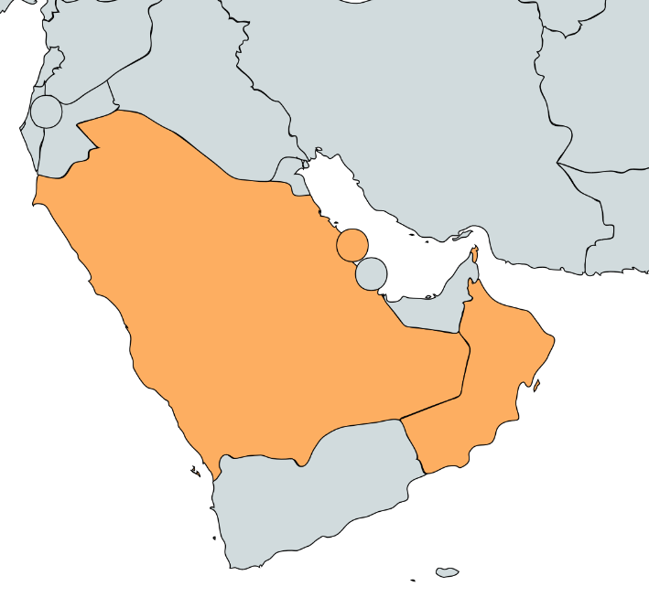













The Consortium: 21 Partners
Research Centre
Large Companies
Universities
SMEs

Slide 8
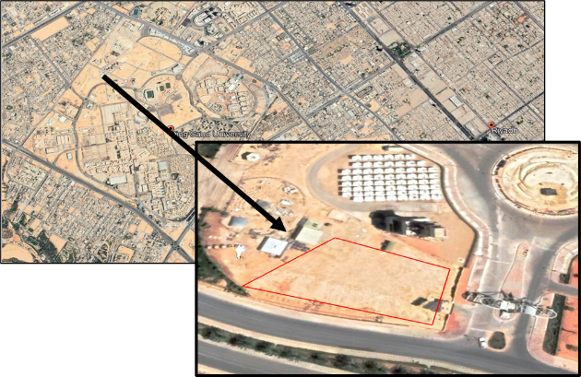
Demonstration site

Slide 9
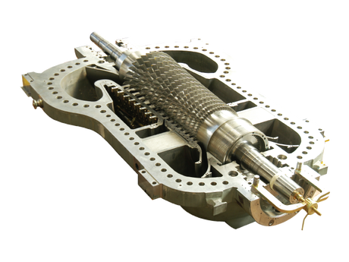
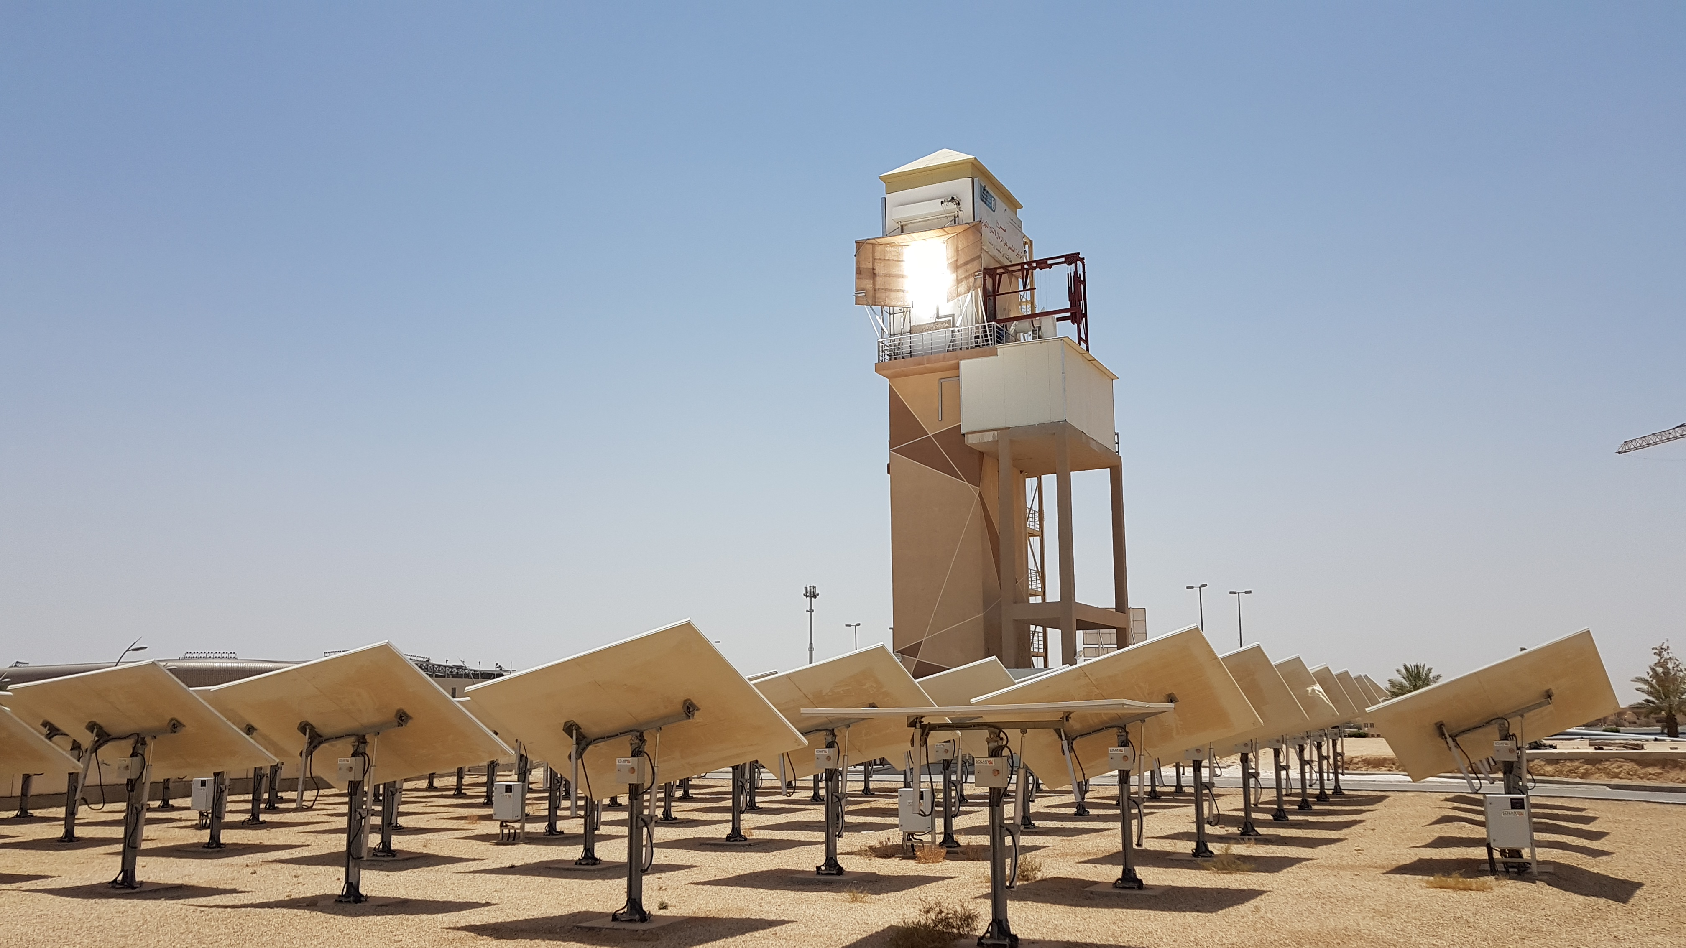
From the concept to the demonstration
1.8 MWel
Desalination section – FO+MD
Metal recovery
FO
MD
ZLD
TRL 4
>2300 hours
TRL 7
Sea Water
>2 m³/day
Pure Water

Slide 10








UNIBS role and activities
Vapour-liquid equilibrium test
Thermodynamic properties
EoS calibration
Promising
dopants
CO₂ BLENDS
Dopants identification
Thermal stability test
Identification of the working fluid for the pilot power plant
Working fluid TDN properties definition for the components design
Material compatibility test at the maximum operating temperature to select the proper materials
Long term
thermal stability test

Slide 11
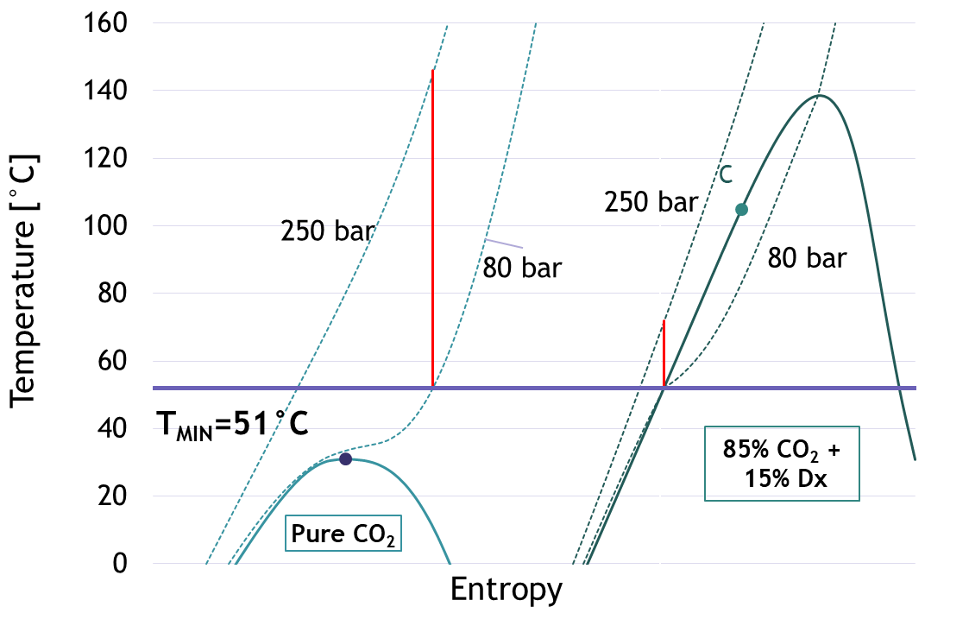
UNIBS role and activities
CO₂ BLENDS
Dopants identification
Identification of dopants for blending CO₂
An ideal dopant should:
Be Thermally stable at high temperature (550°C)
Have a critical temperature > 100°C
Other dopant characteristics:
Melting point < T ambient
 avoiding pipes clogging at ambient temperatures
Solubility with CO₂
High molecular complexity
Environmental friendly (if possible)
Supercritical cycle
Transcritical cycle
SCARABEUS concept

Slide 12
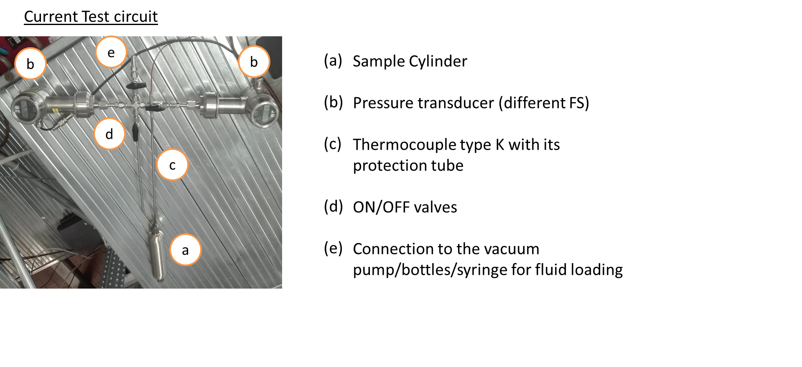
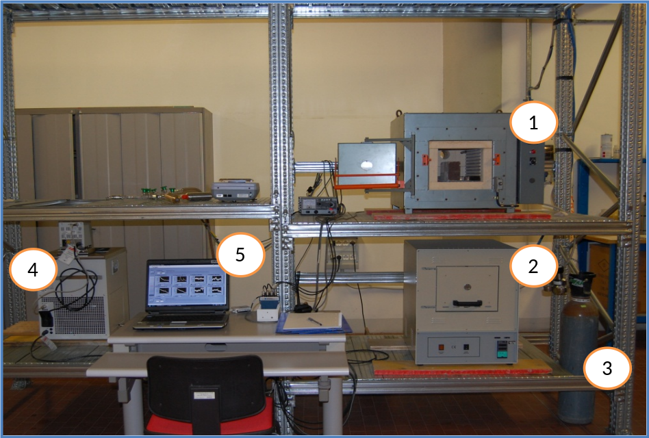
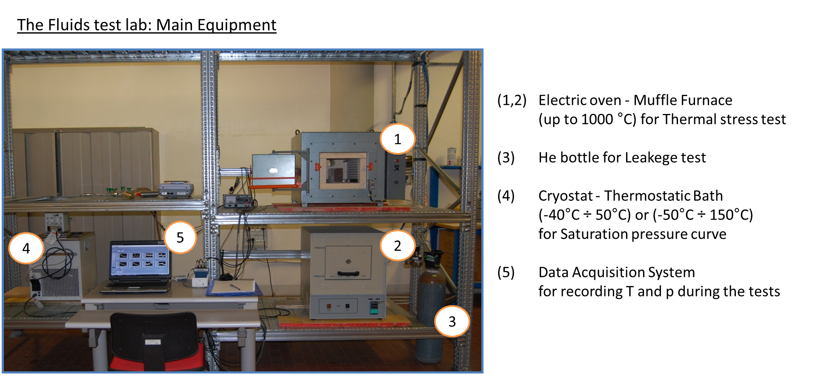
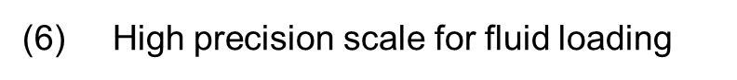
UNIBS role and activities: Thermal stability definition and procedure
Main apparatus

Slide 13
UNIBS role and activities: Thermal stability definition and procedure
Thermal stability test procedure (static method)
FRESH MIXTURE
Definition of reference isochoric line (and its uncertainty)
THERMAL STRESS
100 h at different temperatures
p,T
measurements
COMPARISON &
DEVIATION IDENTIFICATION
Graphical method
New isochoric line after thermal stress VS reference behavior
Two phase (VLE)
Gas phase

Slide 14
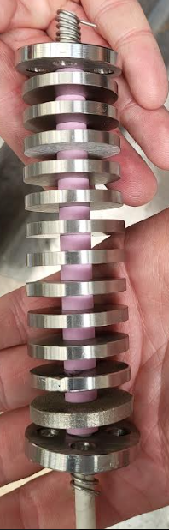
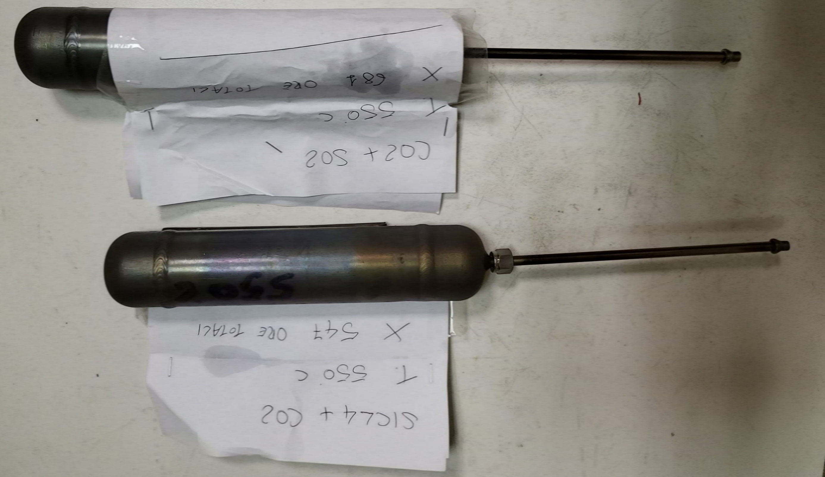
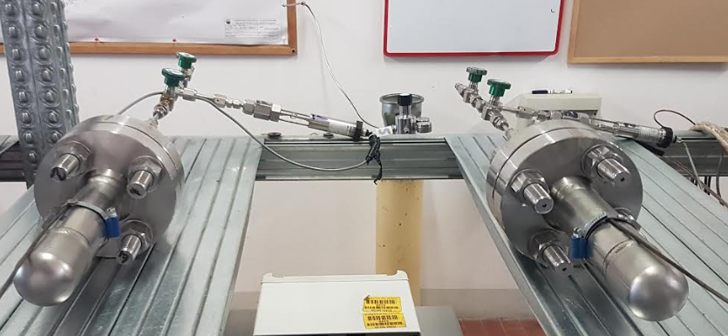
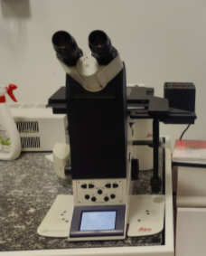
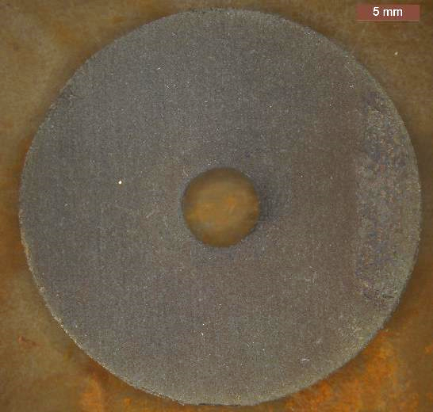
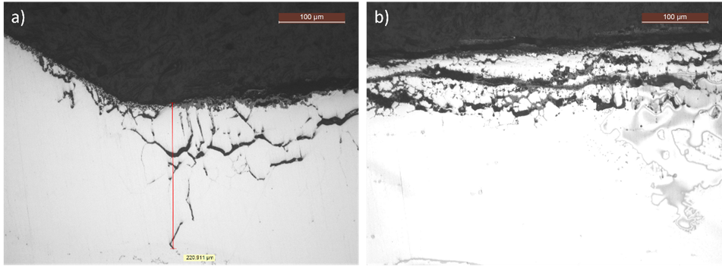
UNIBS role and activities: material compatibility
Material Compatibility Tests
At high temperature, material compatibility info are fundamental
First Campaign: Samples in Welded Cylinder
CO2 blend at 550°C for >500 h
Second Campaign: Samples in Flanged Cylinder
CO2 blend at 550°C for >2000 h
Materials
Ni-alloys
other selected materials….
After Long-term thermal stress test  sample analysis (mass gain, SEM, optical microscope)
Microstructural analysis by means of MeF3 optical microscope equipped with LAS4.12 software for image analysis

Slide 15
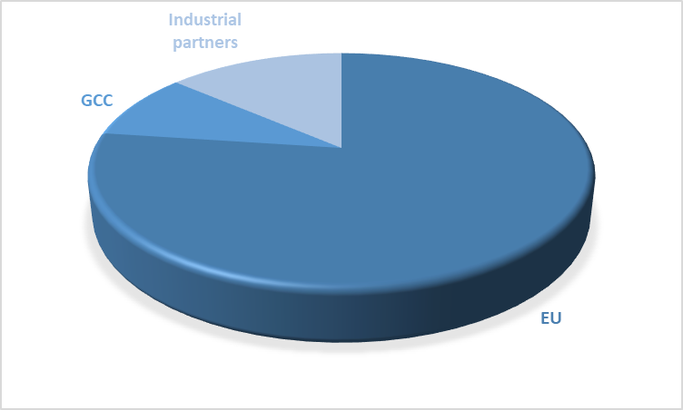
Overall project cost
Call: H2020-LC-SC3-2020-NZE-RES-CC
Efficient combination of Concentrated Solar Power and desalination (with particular focus on the Gulf Cooperation Council (GCC) region)
Overall project budget: +15 M€
International collaboration increases the impact
Private investments are required
Projects are typically budget constraint

Slide 16
Project Milestones and Timelines
2021
Project Inception
The DESOLINATION project kicks off with a focus on integrating CSP and desalination technologies to create sustainable solutions for water and energy
2022-2023
Innovative Thermodynamic Solutions
Groundbreaking work on CO₂ mixtures for thermodynamic cycles leads to effective and efficient coupling of CSP with CO₂-mixtures power cycles and forward osmosis desalination system
Experimental campaign on the coalescer using a solution of water and PAGB2000, obtaining an expression of the separation efficiency, to be deployed in the simulations.
2024
Pilot Plant development
Development of the pilot plant site, marking a significant step towards real-world application and testing of DESOLINATION technologies.
2025
Technology Demonstration
The integration of both existing and next generation CSP cycles will be implemented in the King Saudi University facility to allow testing in a real environment.
2026
Commercialization and Market Uptake
DESOLINATION partners will work on defining a clear roadmap from TRL 6 to TRL 9, ensuring a strong market uptake and exploitation strategy for the developed technologies.

Slide 17

Acknowledgements
The DESOLINATION project has received funding from the European Union’s Horizon 2020 research and innovation programme under grant agreement N° 101022686
www.desolination.eu – LinkedIn Desolination
gioele.dimarcoberardino@unibs.it

